Slide 1
National Flood Policy:
Today? Tomorrow?

Slide 2
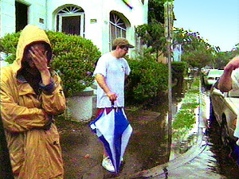
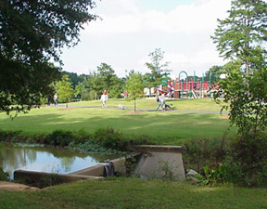
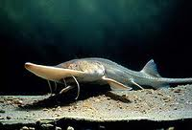

ASFPM’S MISSION
Mitigate the losses, costs, and human suffering caused by flooding.
and…
Protect the natural and beneficial functions of floodplains.
Notes:
As you know, ASFPM is a national non-profit, professional, organization. What you might not know is that ASFPM is a mission driven membership organization. The mission is quite simple – reduce misery caused by floods and protect natural floodplains wherever possible.

Slide 3

What does ASFPM do?
National and State Policy Issues
National CFM® Certification
State Chapter Services & Support
Develop Tools, Publications, & Resources for State and Local Floodplain Managers
No Adverse Impact (NAI)
Conferences & Events
Training (ASFPM Webinar Series)
Flood Barrier Testing & Certification
Research (ASFPM Flood Science Center)
Notes:
ASFPM is a respected national voice in on flooding issues. ASFPM continually provides input to Congress and the Administration. Did you know that ASFPM was the first to promote hazard mitigation? We had a hand legislatively in the formation of the Hazard Mitigation Grant Program in the Stafford Act to the FMA program and even Increased Cost of Compliance – all of these were ASFPM ideas in the beginning. ASFPM continues to be an advocate for improved flood mapping – in fact that is how ASFPM was founded by a group of Midwestern states that were having issues with flood maps. We are also an advocating to continue Map Maintenance (unmet needs)
The ASFPM’s certification of floodplain managers through the CFM program has been on of our biggest successes. We now are above 10,000 CFMs in the nation for the first time in 2017!
Of course ASFPM’s annual conference is the nation’s largest event dealing with all things flood. The 2018 annual conference will be in Phoenix and will have 1,200 to 1,500 attendees with lots of training sessions and field tours.
Finally ASFPM’s Flood Science Center section undertakes projects that involve research, development of tools and publications for practitioners, and develops unique datasets collected by ASFPM.
So lets look at a few of these items in more detail.

Slide 4

Policy: Where Are We At?
The broad problem of flood-loss reduction is that the rate at which flood losses are being eliminated by construction of engineering or land-treatment works is of about the same magnitude as the rate at which new property is being subjected to damage. - GFW
Notes:
ASFPM dedicates a significant amount of resources to follow and input into national policy issues that affect floodplain managers. Our national policy team includes staff in the ASFPM Executive Office and in Washington DC. Policy decisions made in Washington DC have a profound effect on our communities and we must ensure that from a floodplain management perspective we are constantly pushing in the direction of effective floodplain management policies.
[GFW is Gilbert Fowler White]

Slide 5

Federal Budget (FY19)
Program | Administration | House | Senate
FEMA -Flood Mapping | $100 m | $262.5 | $250
FEMA – Pre Disaster Mitigation (PDM) | $39 m | $249 | $250
FEMA – Flood Mitigation Assistance (FMA) | $175 m | $175 | $175
Very good budget numbers by the House and Senate!
Notes:
The good news is that the February 9th budget agreement in Congress increased domestic program spending caps for FY19 too. But you can see that the Administration’s budget is at least better than what was proposed in FY18. Of course the omnibus for 2018 is the basis for what we will advocate for 2019 funding.

Slide 6

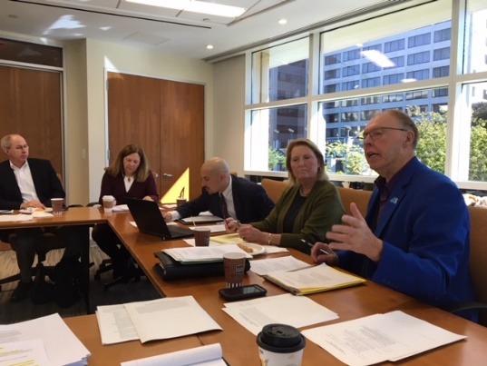
Federal Budget (FY19)
Once again, the Administration’s proposal was bad for many programs that fund floodplain management and hazard mitigation. Luckily the Senate and House disagree!
While part of the Federal budget for FY19 has been passed, FEMA’s budget has not, currently FEMA is on a continuing resolution. Big unknown is how border wall expenses will affect FEMA’s budget.
ASFPM and the National Association of Realtors have just reestablished the flood map coalition to maintain flood map funding!
Notes:
Currently, FEMA is on a continuing resolution. It is likely that the FEMA budget will be addressed in a lame duck session of Congress after the midterm elections. While the previous slide showed quite promising numbers for FEMA programs, the big unknown is funding for the border wall. Many of us speculate that if funding is needed for that, it will have to come from somewhere in the DHS budget. Will this affect FEMA? Will it affect mapping? We will have to see. But we are not waiting passively. In October, ASFPM and the National Association of Realtors reestablished the flood map coalition. ASFPM is also hearing that there are some threats to map funding requests from this Administration on the horizon and with a number of mapping issues on the table, we thought it appropriate to explore another iteration of the flood map coalition. The inaugural meeting had representatives from 20 organizations!

Slide 7
Federal Budget (FY19)
USACE – Lots of new project authorizations, not a significant level of new funding; in the meantime O&M costs continue to increase.
USDA – Problem is that with farm bill expired, conservation programs are curtailed; they are always threatened anyways.
Disaster (emergency) supplementals:
  Given frequency of disasters, seems to happen more often
  Huge amounts for USACE (FY 18 approps $7 billion, emergency supplemental $17.4 billion)
  Huge amounts for HUD through CDBG-DR program
  Off budget, ‘officially” doesn’t violate PAYGO
Notes:
Currently, FEMA is on a continuing resolution. It is likely that the FEMA budget will be addressed in a lame duck session of Congress after the midterm elections. While the previous slide showed quite promising numbers for FEMA programs, the big unknown is funding for the border wall. Many of us speculate that if funding is needed for that, it will have to come from somewhere in the DHS budget. Will this affect FEMA? Will it affect mapping? We will have to see. But we are not waiting passively. In October, ASFPM and the National Association of Realtors reestablished the flood map coalition. ASFPM is also hearing that there are some threats to map funding requests from this Administration on the horizon and with a number of mapping issues on the table, we thought it appropriate to explore another iteration of the flood map coalition. The inaugural meeting had representatives from 20 organizations!

Slide 8
NFIP Reauthorization
NFIP expires 11/30/18.
Most likely scenario is extending it until sometime in 2019 and “starting over” with new Congress.
House passed bill in November 2017
  Focus is on fiscal solvency and privatization of program
  ASPFM has significant concerns
Three Senate bills in play: Committee (Crapo-Brown), SAFE Act (Menendez), and Cassidy-Gillibrand.
  ASFPM supports all three
ASFPM developed/updated Principles and Priorities documents for reform urging further hearings.
Notes:
The most likely scenario is that there is another short term reauthorization for a year or less kicking the can until 2019. But if that happens, then we will be seating a new Congress in 2019 and they essentially start over. The 2017 bill the house passed would die and they would have to try again. In the Senate, since no bill has actually passed, it would be likely the that the three bills in play would be re-introduced as they are all bipartisan and comprehensive. The House bill is too partisan at this point.
ASFPM has been very involved over the past two years on NFIP reform and reauthorization, testifying in front of Congress, working with other national organizations, and working with FEMA on reform ideas. ASFPM has established the following principles for reauthorization of the NFIP in 2017:
Reauthorize, fund and enhance the National Flood Mapping Program (NFMP). Authorized by the 2012 reform act at $400 million annually, the NFMP is still desperately needed to map approximately 3 million miles of unidentified flood hazard areas, identify dam failure zones and maintain the existing inventory of 1.2 million miles of flood studies.
Forgive the NFIP debt (currently at about $20.5 billion). The NFIP, as designed by Congress, was never intended to fully repay claims from catastrophic events. Full repayment of interest and principal – especially as interest rates rise - undermines the financial stability of the NFIP and will be impossible to accomplish.
Ensure a system where a strong NFIP co-exists with private sector flood policies. Require private flood providers to share in costs to maintain flood mapping and floodplain management efforts. Ensure changes to facilitate private flood policies do not harm other elements of the NFIP: mapping, mitigation, and floodplain management.
Address NFIP affordability issues that will re-emerge in the next 3-5 years. While ASFPM supports the continuation of the current glide path towards actuarial rates to facilitate accurate risk messaging and promote mitigation, flood insurance affordability was largely ignored in previous two reform bills and must be addressed now. Affordability subsidies should support mitigation, rather than subsidize insurance premiums only.
Support and strengthen the mitigation elements of the NFIP, especially Increased Cost of Compliance.
Strengthen compliance with mandatory insurance provisions of the NFIP. Two areas are particularly problematic – owners maintaining flood insurance policies as a condition of loans after the first few years and owners maintaining policies after receiving disaster assistance and/or after the 3-year group flood insurance policy expires.
The ASFPM Priorites document has more specific legislative proposals. These ideas came from ASFPM leadership as well as the grassroots effort that likely some of you participated in when we developed our 2015 National Flood Policies and Programs in Review!

Slide 9
Disaster Reform and Recovery Act (DRRA)
Signed into law in October 5, 2018 it has several sections positively impacting floodplain management and hazard mitigation:
  Allows for reimbursement through Public Assistance of mutual aid assistance for substantial damage and building inspections post-disaster (this is language ASFPM wanted in law).
  Increases allowable grantee and subgrantee management costs under HMGP and PA; this will help build capability.
  Authorizes the availability of HMGP for fire management (FMAG) disaster declarations and identifies several specific types of eligible mitigation activities that impact flood risk management.
  Authorizes hazard mitigation assistance as part of Economic Development Administration economic adjustment grants.
  Deems that a disaster loan is not a duplication of benefits.
Notes:
The DRRA is probably one of the most significant reforms of the Federal Stafford Act, especially from a hazard mitigation and floodplain management perspective since the Disaster Mitigation Act of 2000. While there have been other reforms since 2000, most have focused on response and recovery. It is fair to say that a primary focus of the DRRA is on hazard mitigation and that could have a significant impact on the day-to-day work of floodplain managers and hazard mitigation professionals.
So what is in the DRRA? What is good about it?
Perhaps the most important provision to ASFPM was a change in law aimed at specifically repealing an almost 20-year old policy by FEMA that specifically disallows the reimbursement of activities like most building inspections and substantial damage determinations through the Public Assistance Program. Why this is so important is that when an activity is eligible for reimbursement, communities and states are much more likely to request mutual aid assistance through mechanisms like EMAC. Now with this change in law, communities can request help through EMAC to do substantial damage determinations and tap into floodplain managers from throughout the country that are willing to help.
For those dealing with mitigation grants, the increase in management costs is a big deal; often state mitigation programs are mostly supported through these management costs.
For western states and Florida – there is now a permanent authority to trigger HMGP whenever a Fire Management declaration is issued. So just like for major disasters, HMGP will be available after FMAG declarations and there are several specific types of mitigation actions identified that actually reduce flood risk.
Another provision would authorize the Department of Commerce Economic Development Administration to make hazard mitigation assistance eligible under economic adjustment grants. This is a new pathway for hazard mitigation assistance that could be useful.

Slide 10
Disaster Reform and Recovery Act (DRRA)
Big changes for the Pre-Disaster Mitigation Program:
  Authorizes new technical/financial assistance category for establishing, implementing, and enforcing latest building codes.
  Gives FEMA authority to withdraw PDM assistance and provide it to other states through a competitive program if awarded funds are not obligated in 3 years from initial obligation.
  Adds two new criteria for PDM award selection/assistance which are to what extent has the applicant adopted and enforced the latest building codes and to what extent will the project increase the level of the community’s resiliency.
  Changes the funding for PDM to a formula based on 6% of estimated disaster costs.
Notes:
But the biggest mitigation changes in the DRRA are to the pre-disaster mitigation grant program. There are four major changes.
PDM will now be able to be used to establish/implement/enforce the latest building codes. According to a blog by the CEO of the International Code Council: 16% of the population lives in communities with codes that are at least 9 years old and at least 2 million people live in communities with codes that are at least 15 years old. Eight states with statewide code requirements are on building codes that are 9 or more years old. These states cover nearly a quarter of the U.S. population. Lack of resources is the primary reason communities do not update their codes to more recent editions or enforce the codes they have in place.
FEMA would have new authorities to redistribute unused PDM funds after three years of obligation and now, for the first time, a criteria for selecting/awarding PDM assistance is to what extent the applicant has adopted and enforced the latest building codes.
Finally and this is huge. PDM will now be based on a formula versus having to have an appropriated amount by Congress. In nearly 20 years since the creation of PDM, funding has swung wildly. Recently, for three years in a row, the Administration actually proposed to zero out PDM. It has been funded as high as $250 million (last year). Now it will be 6% of certain disaster expenditures from the previous year. What does that mean in reality. Brock Long, the FEMA admin

Slide 11
Disaster Reform and Recovery Act (DRRA)
TWO BIG PROBLEMS
  Would allow Governors to waive the concept of duplication of benefits for virtually any post-disaster funding.
  Eliminates requirement that all buildings on a campus have flood insurance as a condition of receiving public assistance funds.
Notes:
So here are the two big problem areas with the new DRRA.
First, Section 1210 could be very detrimental to non-structural mitigation. Specifically the section would allow HMGP funds to be used for Corps of Engineers authorized projects under the Water Resource Development Act. This means HMGP could be a project that was authorized decades ago that may no longer be cost effective. ASFPM is concerned that by now allowing HMGP to be used for these project, the big loser will be non-structural mitigation projects as they are usually not perceived as an “easy solution” like building a levee is or channelizing a creek or river.
The second problem isn’t nearly as large, but it does chip away at the concept of public building owners taking responsible actions to reduce risk. Previously, public assistance was not provided, or was reduced by the amount of insurance that should have otherwise been obtained, for public buildings. Now, Section 1207 would waive this requirement in cases where there is more than one building on a single campus. Here is an example. Lets say that there was an educational campus that had several flood prone buildings on it damaged by a flood. Under previous law, every building that was damaged had their public assistance reduced if they did not have adequate flood insurance coverage. The new law change says that on such a campus, no more than one building can be penalized for not having insurance or being underinsured, but the others will not….even if they did not have flood insurance! Talk about dialing back the personal responsibility!

Slide 12
Water Resource Development Act (WRDA)
Just signed yesterday by President Trump
  Requires consideration of natural and nature based alternatives for flood risk/hurricane/storm damage projects (Sec. 1149).
  Makes permanent a program to deal with ice jam flooding (Sec 1131).
  Does not include language eliminating floodplain management plan requirement for recipients of high hazard dam rehab program funds (defensive win).
  Creates more formalized process for project deauthorization…but…will it actually make it harder to deauthorize non-feasible project? Or easier?
Notes:
So here are the two big problem areas with the new DRRA.
First, Section 1210 could be very detrimental to non-structural mitigation. Specifically the section would allow HMGP funds to be used for Corps of Engineers authorized projects under the Water Resource Development Act. This means HMGP could be a project that was authorized decades ago that may no longer be cost effective. ASFPM is concerned that by now allowing HMGP to be used for these project, the big loser will be non-structural mitigation projects as they are usually not perceived as an “easy solution” like building a levee is or channelizing a creek or river.
The second problem isn’t nearly as large, but it does chip away at the concept of public building owners taking responsible actions to reduce risk. Previously, public assistance was not provided, or was reduced by the amount of insurance that should have otherwise been obtained, for public buildings. Now, Section 1207 would waive this requirement in cases where there is more than one building on a single campus. Here is an example. Lets say that there was an educational campus that had several flood prone buildings on it damaged by a flood. Under previous law, every building that was damaged had their public assistance reduced if they did not have adequate flood insurance coverage. The new law change says that on such a campus, no more than one building can be penalized for not having insurance or being underinsured, but the others will not….even if they did not have flood insurance! Talk about dialing back the personal responsibility!

Slide 13
Other FY19 Items
Digital Coast Act
  Passed Senate unanimously, awaiting vote in House
Farm Bill
  There has been some recent activity; ASFPM’s interest is in conservation programs
New Congress is seated in calendar year 2019 so any pending legislation disappears and we start over
ASFPM working singularly and with coalitions to influence these important pieces of legislation!

Slide 14

National Flood Policy: Where Are We Going?
Notes:
As floodplain managers, we know that we need data, techniques, and tools to do our jobs effectively. That is why ASFPM and the Flood Science Center of ASFPM exist – to make your lives easier and to enable the floodplain management practitioners to be successful. For the next few slides, I want to highlight some of the projects and research that the FSC is doing…

Slide 15
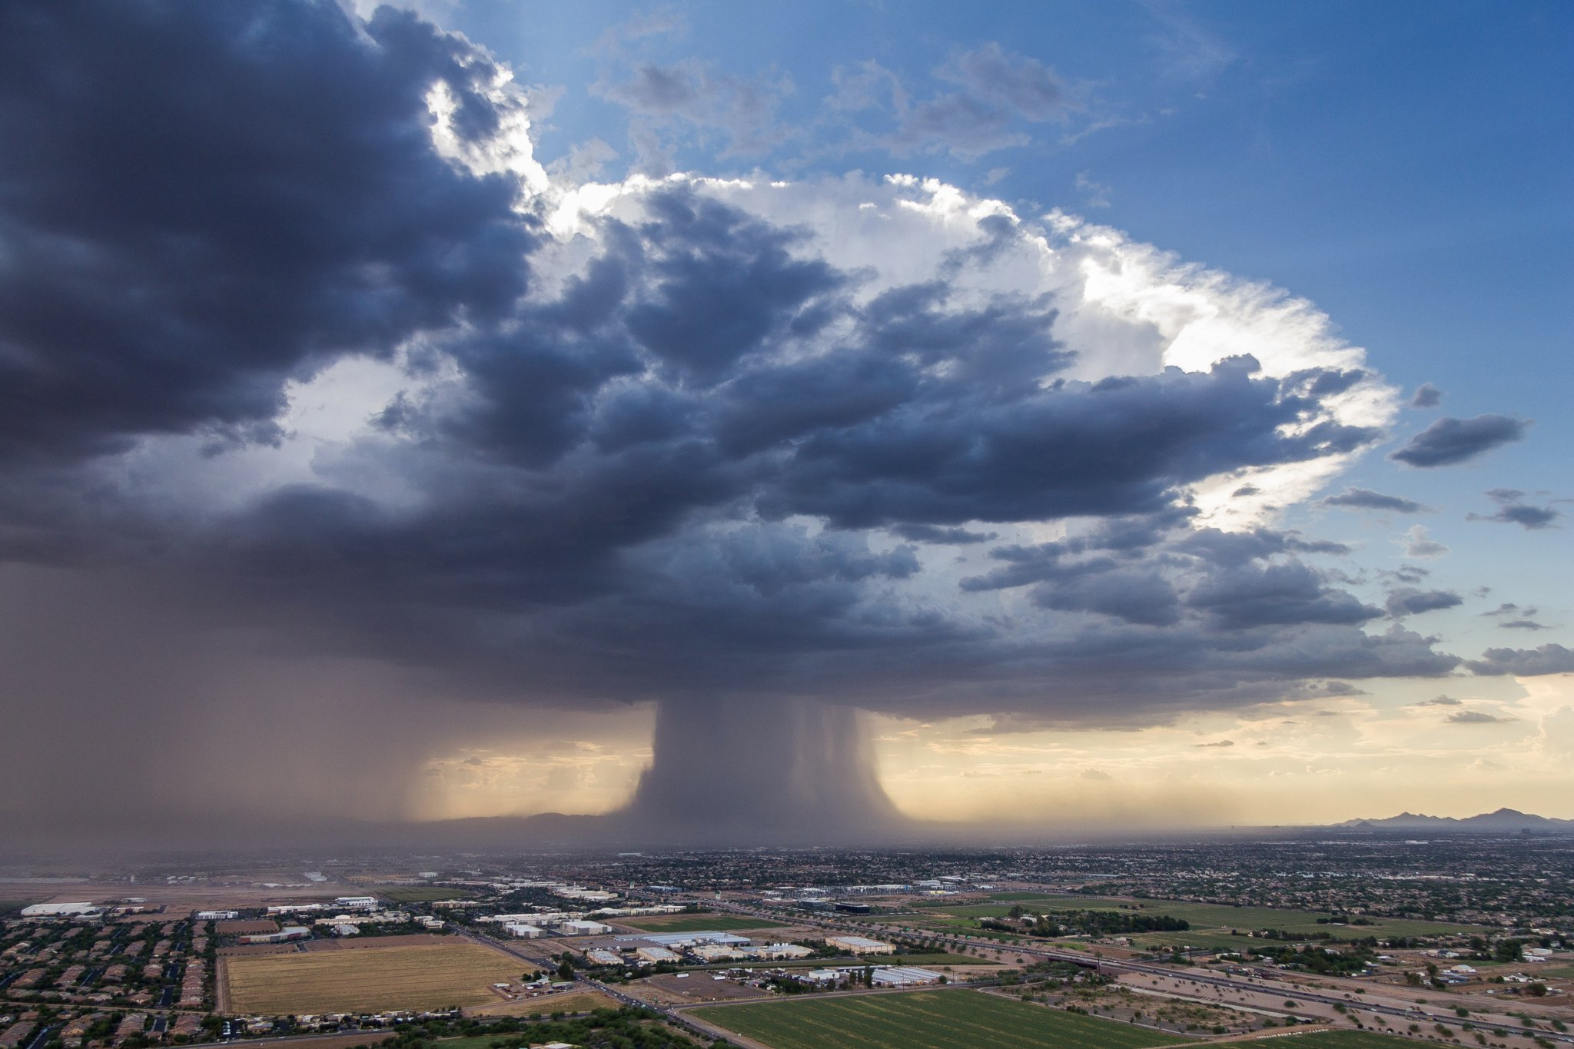
OUR CHALLENGE
Credit: Chopperguy Photographer Jerry Ferguson and Pilot Andrew Park
Notes:
Today, we are seeing an unprecedented number of extreme weather events. The so called 500, and 1,000 year events seem to be occurring every month or two, whether it is a Rain Bomb microburst over Phoenix pictured here (from this past July), or intense frontal systems, I think it is interesting, and perhaps lucky that we haven’t seen this show up in our tropical storms although some meteorologists in the Sandy affected area believe that the intensity of the storm was enhanced by the warmer climate (warm climate = pure fuel for hurricanes). Lets face it we love to live and be near water, yet these places are becoming more and more hazardous. What do we do about it?

Slide 16
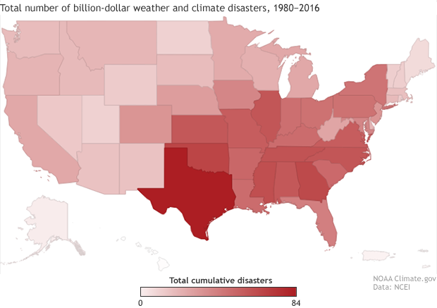
Notes:
One change that as a nation and within our communities that we cannot tolerate much longer is the economic battering we are seeing associated with weather and other disaster events. This is a map of states that have been part of billion dollar weather events since 1980, with Texas leading the way. With flooding alone we are seeing disturbing trends with average annual losses of nearly $6 billion in the 1990s jumping to $10 billion in the 2000s much more this decade. So whose problem is it? Is it just a federal problem, or do states and communities have a stake in it too? How do we cope with these changes, how do coastal communities do a better job preparing for disasters and other events that impact coastal economies?

Slide 17
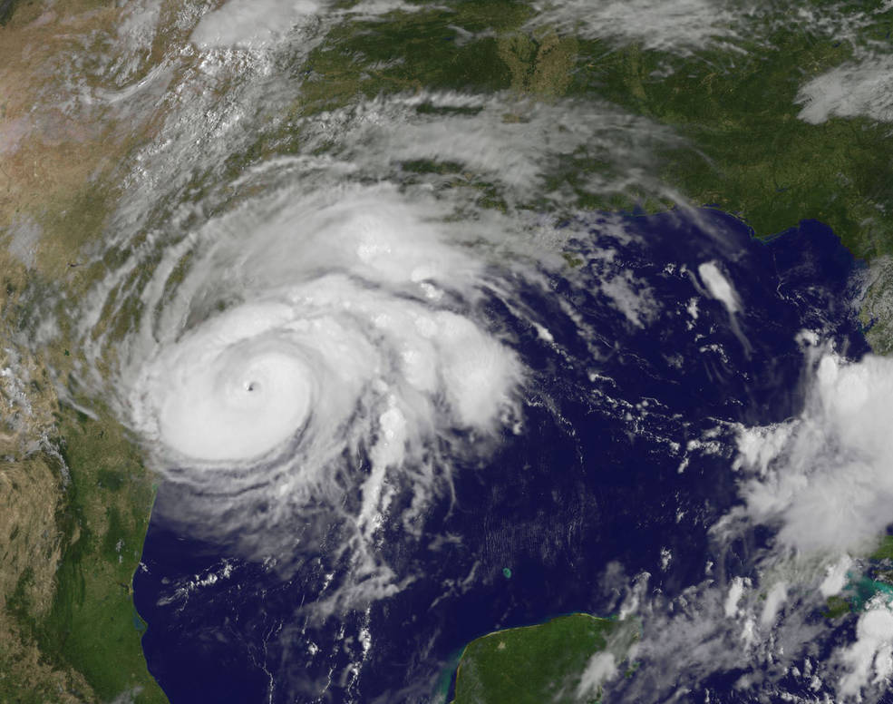
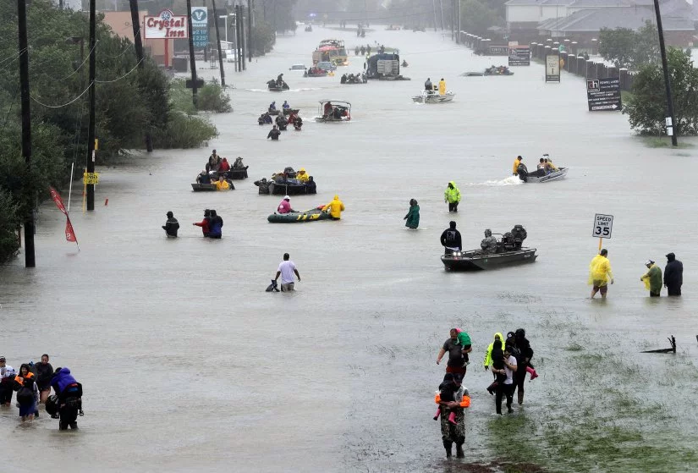
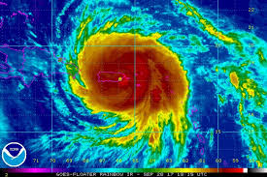
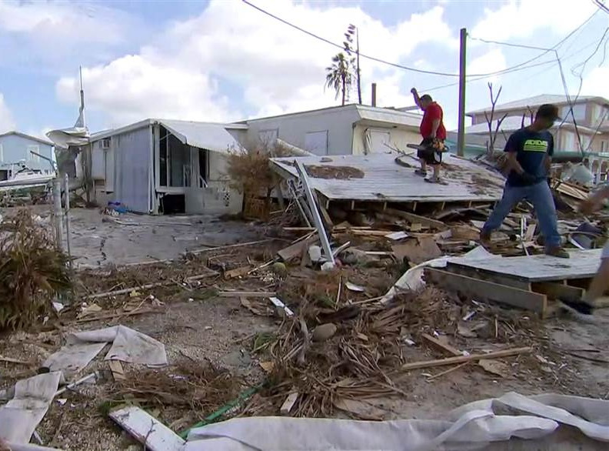
JUST IN: 100% of Puerto Rico is without power amid Hurricane #Maria, Puerto Rico OEM tells @ABC News. http://abcn.ws/2xRe0Wi
1:16 PM - Sep 20, 2017
Notes:
And then there was 2017 with the three hurricanes Harvey, Irma and Maria resulting in at least $300 billion in economic impact. Of course in 2018 we have Florence at about $50 billion and Michael at between $10 billion and $30 billion.

Slide 18
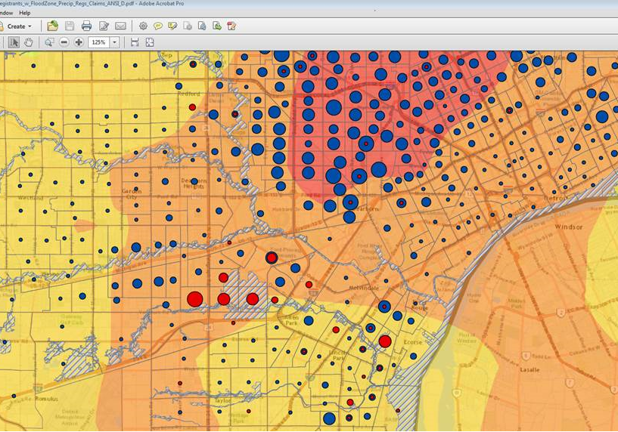
Notes:
It turns out that our flooding threat is coming from everywhere. Urban flooding, flooding due to old or inadequate flood control infrastructure (old dams and levees), sea level rise, even wildfire, is in addition to normal old riverine and coastal flooding that we have experienced since human settlement began. This is an IA heat map from a summer rain event in 2014 in Detroit where up to six inches of rain fell in two days. The result? A flood disaster with over 125,000 IA registrants and over $250 million in federal assistance being provided. The things that look like streams and rivers are the FEMA flood maps. But zooming in really tells another story. Look at all the flooding where we do not have flood maps? How do we translate this data into data that communities can use for floodplain management purposes? How do we translate this into products that communicate flood risk?

Slide 19
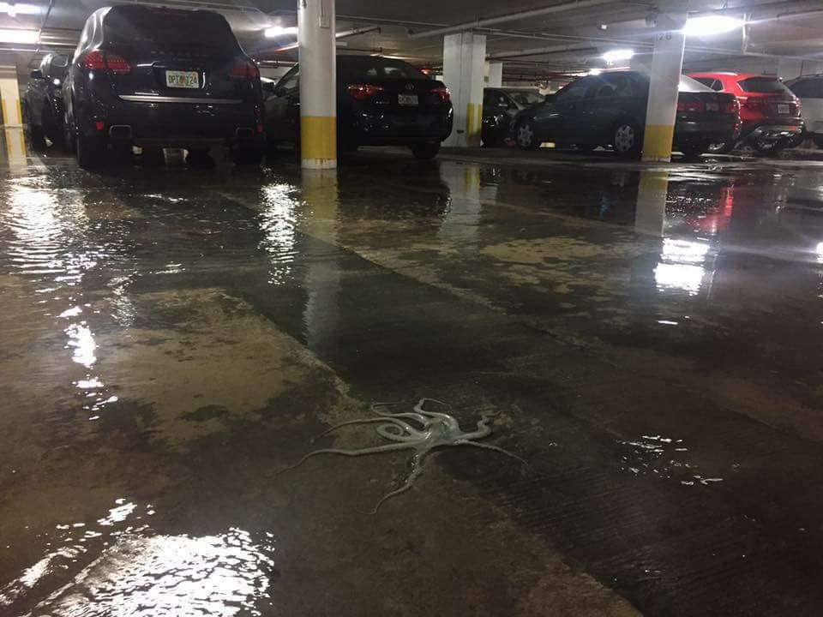
OUR CHALLENGE
Credit: Chopperguy Photographer Jerry Ferguson and Pilot Andrew Park
Credit: Richard Conlin, Facebook Picture
Notes:
Or sea level rise like is pictured here during a King Tide during a supermoon near Miami Beach where flooding from rising tides has increased 400 percent since 2006.
Well we had better not wait too long to take action because the storm is already forming. In what I think is one of the most important articles published in 2016, is one written by the Chief Economist of Freddie Mac. In discussing flooding as a result of sea level rise and climate change that the total economic losses and social disruption of this flooding will likely be greater in total than those experienced in the housing crisis and Great Recession. Further, it speculates that if and when homes become uninsurable and/or unmarketable (due to lack of financing), the values of homes will plummet, perhaps to zero with no hopes of recovery. And if this uplifting story couldn’t get any better, it describes the challenge of timing and housing prices/ Will the value of such homes at risk decline gradually as the expected life of the house becomes shorter or will the value of the house, and all the houses around it plunge the first time a lender refuses to make a mortgage on a nearby house or an insurer refuses to issue a homeowners policy. Make no mistake, the canary in the coal mine is the housing finance/insurance industry!

Slide 20
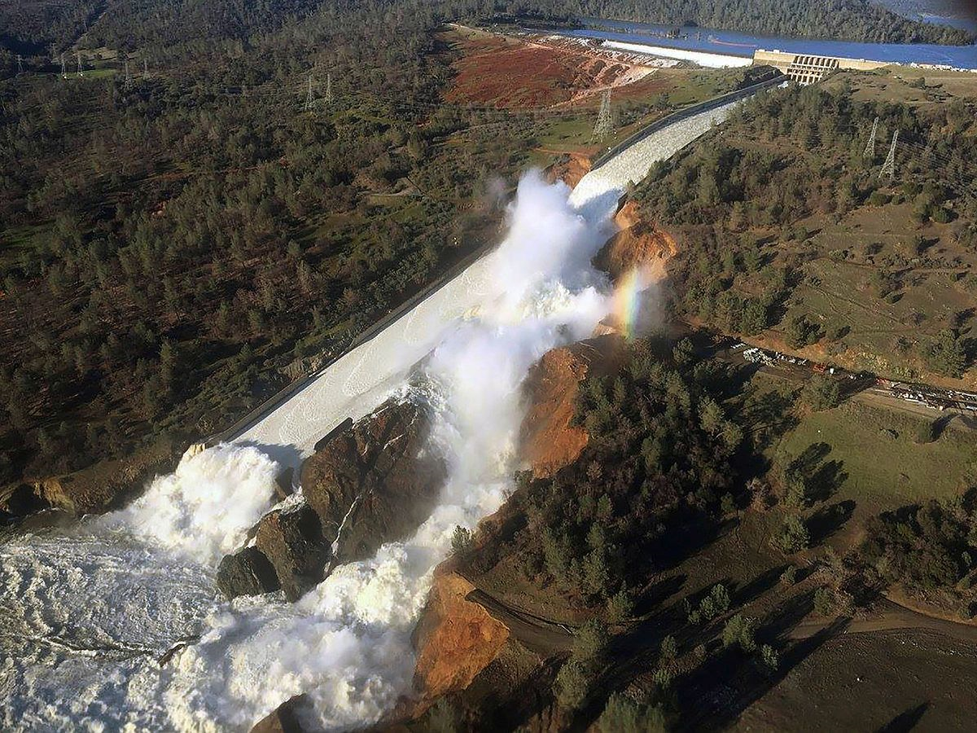
OUR CHALLENGE
Credit: Chopperguy Photographer Jerry Ferguson and Pilot Andrew Park
Credit: Richard Conlin, Facebook Picture
Notes:
Or a nearly catastrophic dam failure like what happened on the Oroville Dam – the nation’s highest – in February 2017. This past January the LA Times reported that repairs to the Oroville are over $870 million and climbing. 200.000 people were evacuated downstream. An independent report released this past January concludes that human error was made by a number of organizations but say that the dam's owner, the California Department of Water Resources, was "significantly overconfident and complacent about the integrity of its State Water Project civil infrastructure, including dams."

Slide 21
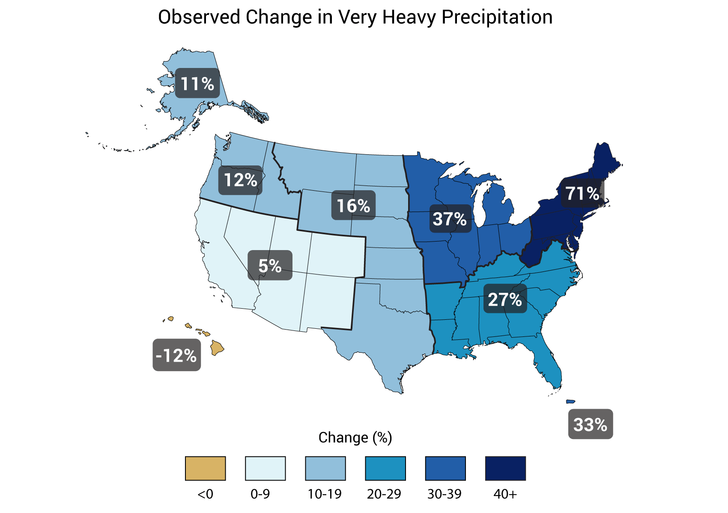
The Climate is Changing
Ability now to downscale global and national climate models
Impacts on flood risk vary with location
Coastal impacts and science tend to be more advance than riverine
Some areas, less rain, but more potential extreme flooding
Notes:
This is from the National Climate Assessment and based on past data. and is the trend from 1958-2012.
We must deal with a changing environment both inland and on our coasts. From a disaster perspective, things seem to be getting worse. Whether it is anecdotal information from parents and other relatives or data such as this from the national climate assessment looking back at the historical record and incorporating recent events, we are seeing more extreme rainfall events. And this is not just an inland phenomena. For example on our Fresh Coast, in Milwaukee, WI, just analyzing the past 10 years of records and including them into the data, their statistical 24 hour, 100-year frequency rainfall amount has increased 13%. We are increasingly seeing hurricanes whose formidable surge and wind threats are being dwarfed by their rainfall. Are we prepared?

Slide 22
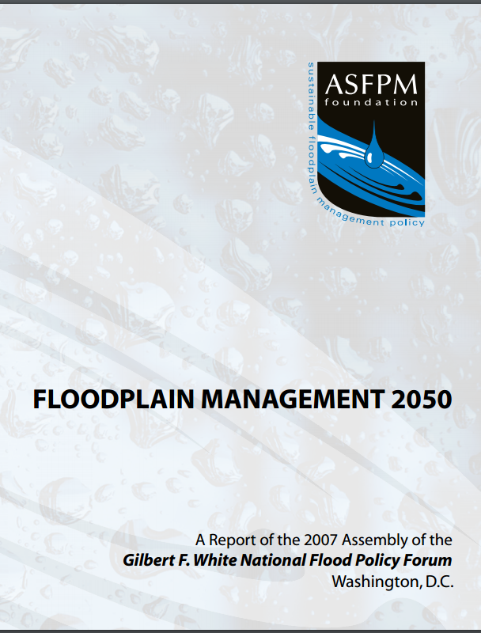
Demographics are too!
By 2050:
460 million people in the US
200 million housing units (up from 116 million in 2000).
  Between replacement units and new units, 90% of units in 2050 will have not existed in 2000
180 billion sq. ft. non-residential space (up from 80 billion in 2000)
  Between replacement and new space, 225% of spaced will not have existed in 2000.
Average life span of homes – over 150 years!
  Source: Arthur Nelson, Metropolitan Institute at Virginia Tech.
Notes:
One of the activities of the ASFPM does – actually the ASFPM Foundation - periodically hosts a ASFPM Foundation Forums in Washington DC. Typically held every three years, the Forum brings in national experts and thinkers to debate a topic related to floodplain management. These statistics came from one of those presentations during the 2007 forum. Where is all of this going to go? We had better have all hazards mapped. Also, are we putting in place in our planning and land use systems ways to make sure all of this development is resilient?

Slide 23
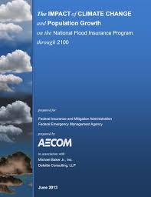
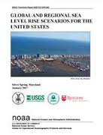
Flood Hazards are Changing
More “1,000-year” floods & areas getting multiple 100-year + floods
Riverine floodplains expected to grow by 45%, coastal floodplains by 55% by 2100
Upper bound for SLR this century revised upward to 2.5m (8 ft)
Notes:
From an observational standpoint, we are seeing more frequent extreme events. From an analytical standpoint, through the National Climate Assessment and even this report from 2013 on the impacts of climate change to the NFIP – floodplains are growing. One interesting conclusion from the AECOM report is that median flood flows may very well increase even areas that are expected to become drier on average. These data are quite variable regionally.
However, as the science improves and data comes in the scenarios are getting worse, not better. A report released by NOAA just this past January revises the upper bound for sea level rise by 2100 up to 8 feet, with regional variations along US coastlines as high as 9.5 feet due to new data on the melting of the Greenland and Antarctic ice sheets.

Slide 24
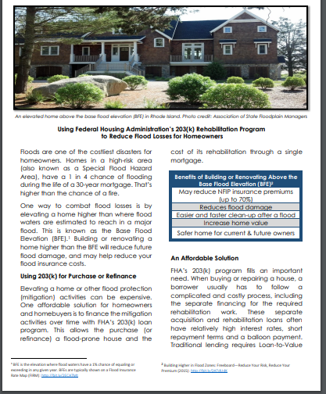
Bottom Line
  Better use of existing programs
  Better use of technology (LIDAR, flood fighting)
  Private sector flood insurance will continue
  More importance on state/local efforts to reduce flood risk
  Federal debt
  Sea level rise crisis will affect the nation
  New flood risks?

Slide 25

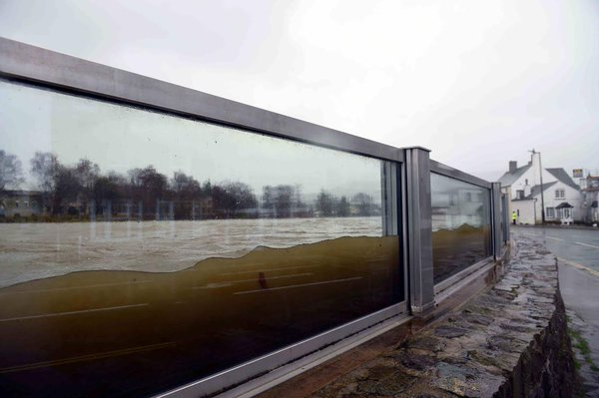

National Flood Barrier Testing & Certification Program
ASFPM leads program to test and certify flood barrier products: www.nationalfloodbarrier.org
Certified products get FM Diamond
Tests 4 types of products: Opening barriers, perimeter barriers, backwater valves, and mitigation pumps
Tests to FM/ANSI 2510 standards
Notes:
The National Flood Barrier Testing and Certification Program is a 15-year effort that began with the AAFPM Floodproofing Committee members who manufacture flood barrier products wanting to ensure that standards were in place for their products to ensure quality and dependability. Fast forward to today and the program, which has three partners: FM Approvals, US Army Corps of Engineers, and ASFPM tests and certifies four types of products to the FM/ANSI 2510 standard. More information on the program can be found at www.nationalfloodbarrier.org, including fact sheets geared towards property and business owners.
Currently ASFPM has a project, working with funding from the Department of Homeland Security, to further promote the program, develop testing standards for the two classes of products that currently have none – semi-permanent barriers and sealants, determine the feasibility of developing standards for low-cost flood sensors also being developed by DHS, and getting the 2510 standard into national building codes. ASFPM is producing a white paper on pathways forward to getting the 2510 standard into national codes and regulations and it is almost completed.

Slide 26

Thank You
The present status of floodplain management does not encourage complacency ... On balance, progress has been far short of what is desirable or possible, or what was envisaged at times when the current policies and activities were initiated - GFW
Credit given to the Natural Hazards Observer and Rob Pudim for all illustrations in this presentation
Be a member, get involved!
www.floods.org
Notes:
Well those are just the highlights of the many, many things ASFPM is involved with right now. Remember, ASFPM is your professional organization! So in closing, I sincerely hope that you are a member of ASFPM’s [STATE NAME] Chapter and if not, please get involved. State chapters are critical, especially in focusing on state legislation and issues.
Remember too, that ASFPM is a direct membership association so if you are not a member of ASFPM, I invite you to join! For those of that are, thank you for your membership and I hope that you feel that we provide you a good return on your investment in us. The entire staff in Madison, Wisconsin and our dozens of volunteer leaders work very hard to earn your membership dollar!
Thank you.

